Slide 1
Actor Network Analysis of IMDb
after Millennium
盧永騰、陳逸瑄、陳昱瑋、林弈呈
第五組

Slide 2
Outline
1
Introduction
4
Evolution
2
5
Data Preparation
Community
3
6
Distribution
Conclusion

Slide 3
Data Preparation
In the beginning, our project is to find out the connection between
the movie and the director
2. We started to clean up the useless data which is in the database
3. We keep the movie field and director field
4. This instruction below is how we keep the field and arrange the data

Slide 4
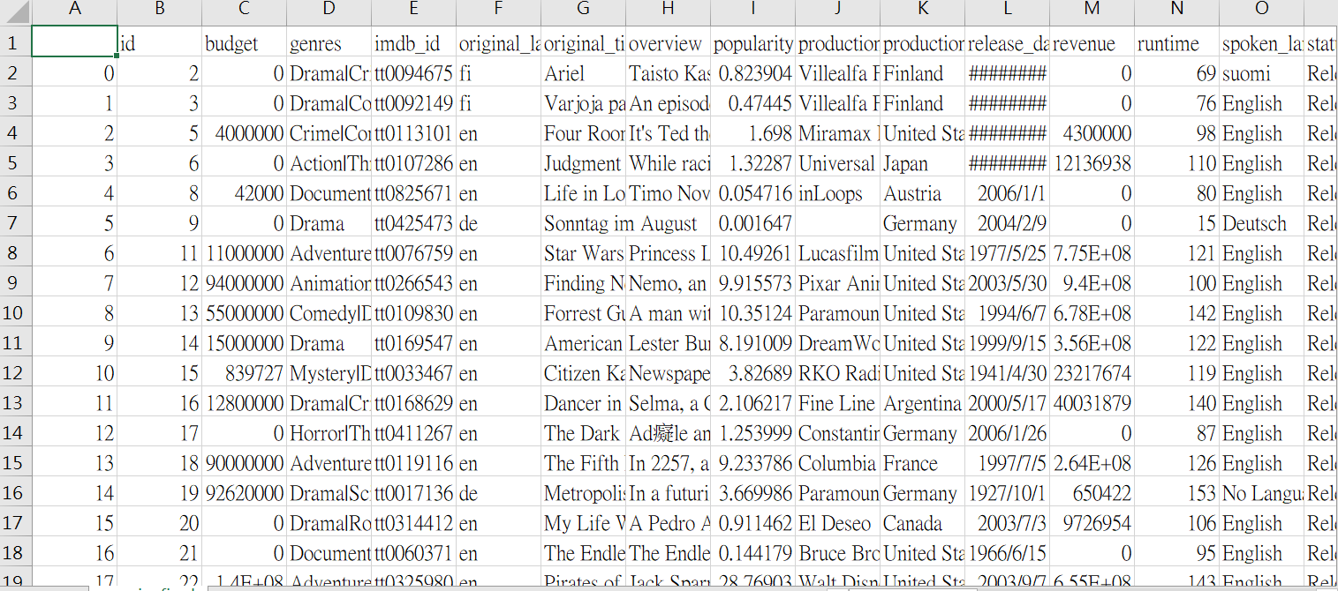
Data Preparation
Original Data

Slide 5
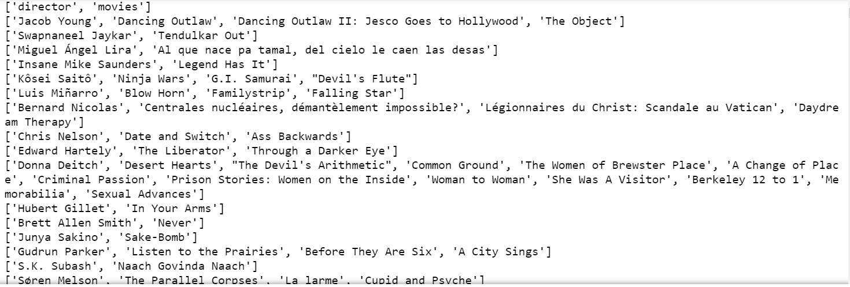
Data Preparation
After Cleaning

Slide 6
Nodes, Edges
Our data are based on directors and their cooperated actors from 2001 to 2018.
We intend to see the network formed by these directors and actors.
Actors ( ,set to be nodes) who have been worked with each other in a same movie will be connected by an edge with the name of its director
Nodes : 146379 (i.e. # of all actors and actresses)
Edges : 641185 (i.e. # of all kinds of working relationship)

Slide 7
Nodes, Degrees, and NETWORK
When it comes to Network, it’s intuitive and reasonable to see if our data fit some frequently-observed (social) network in the past
BA (Barabási-Albert) model
Model includes “Growth” and “Preferential attachment” in its concepts
Additional assumptions of BB model: The “fitness” network begins with a fixed number of interconnected nodes. They have different fitness, which can be described with fitness parameter, which is chosen from a fitness distribution ρ(η).

Slide 8
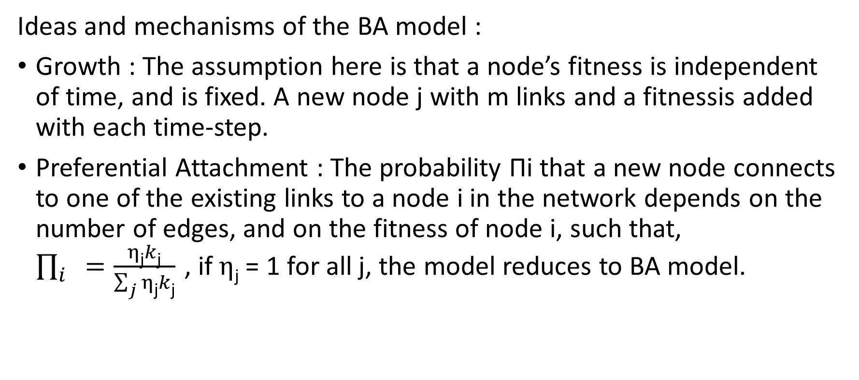
The idea and construction of BA model
Ideas and mechanisms of the BA model :
Growth : The assumption here is that a node’s fitness is independent of time, and is fixed. A new node j with m links and a fitnessis added with each time-step.
Preferential Attachment : The probability Πi that a new node connects to one of the existing links to a node i in the network depends on the number of edges, and on the fitness of node i, such that, $\prod_{i}{=\frac{η\text{j}k\text{j}}{\sum_{j}{η\text{j}k\text{j}}}}$, if $η\text{j}$ = 1 for all j, the model reduces to BA model.

Slide 9
The idea and construction of BA model
Disadvantages of the BA model:
The BA model does not consider the “death” of a node.
The BA model does not consider intrinsic properties of nodes or links, that is, no further assumption other than the weighted probability.
This is most likely the reason that our data don’t fit power law distribution.
Properties of BA model :
Scale free : γ = 3 and Fat tail
Rich gets richer and First mover advantage

Slide 10
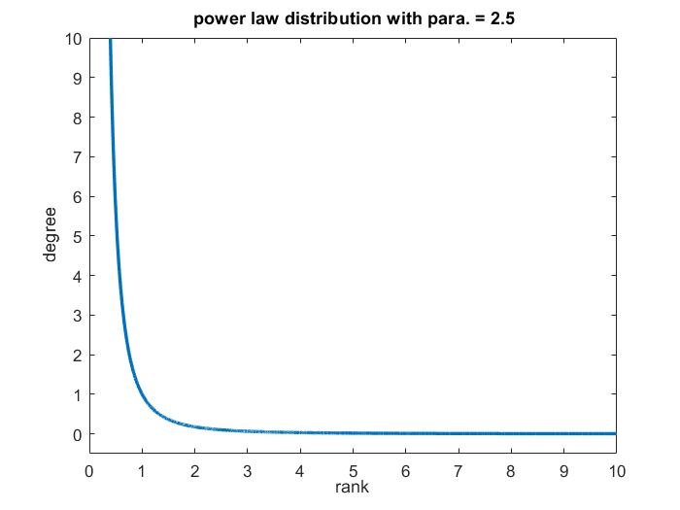
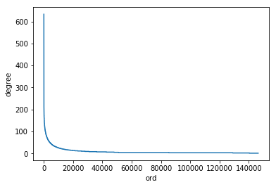
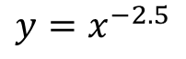
Distribution w.r.t. Ranks and Degrees
Does our data fit the power law distribution？
$$y=x^{−2.5}$$

Slide 11
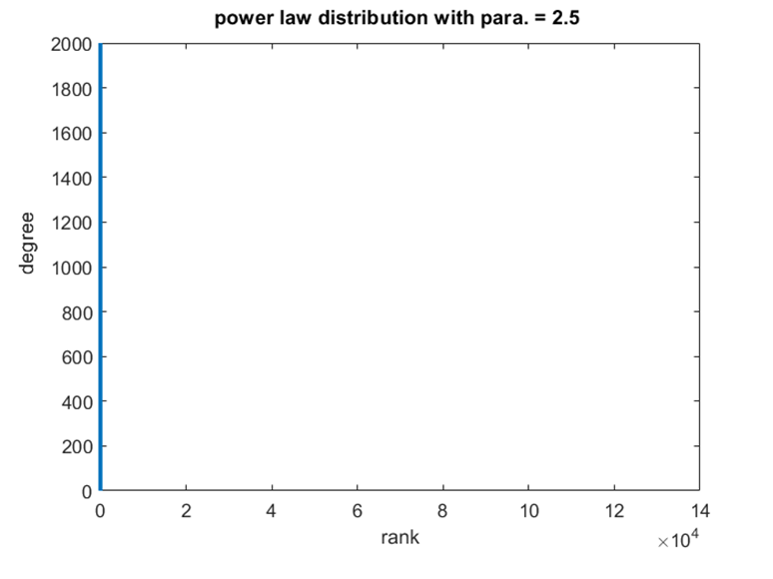
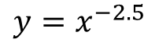
Distribution w.r.t. Ranks and Degrees
Does our data fit the power law distribution？
$$y=x^{−2.5}$$

Slide 12
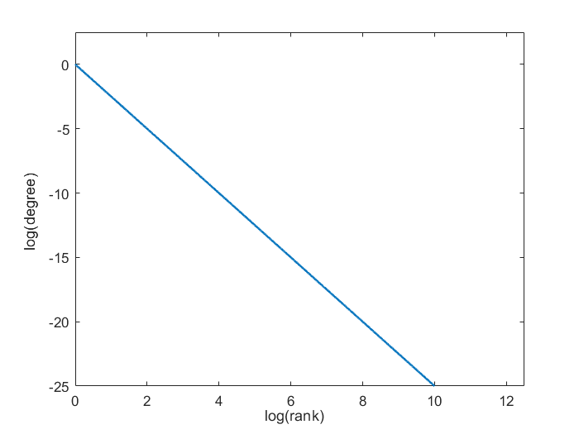
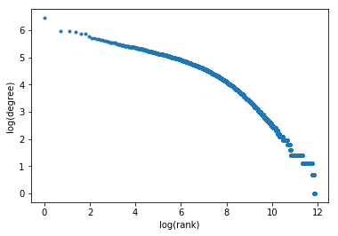
Distribution w.r.t. Ranks and Degrees
Taking log on the values of degree and rank
log y = -2.5 log x
It’s direct to see there’s some difference between the two graphs

Slide 13
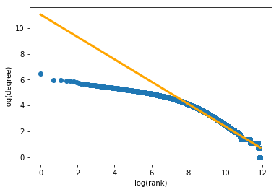
Linear Regression
Corporate BI (Centralized, Managed)
To what extent is the fitness of linear regression can be?
The R squared value is 0.94026

Slide 14
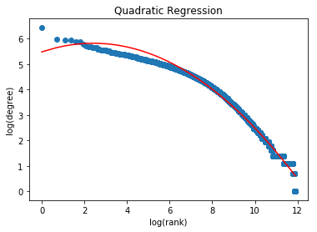
Quadratic Regression
Why consider quadratic regression?

Slide 15
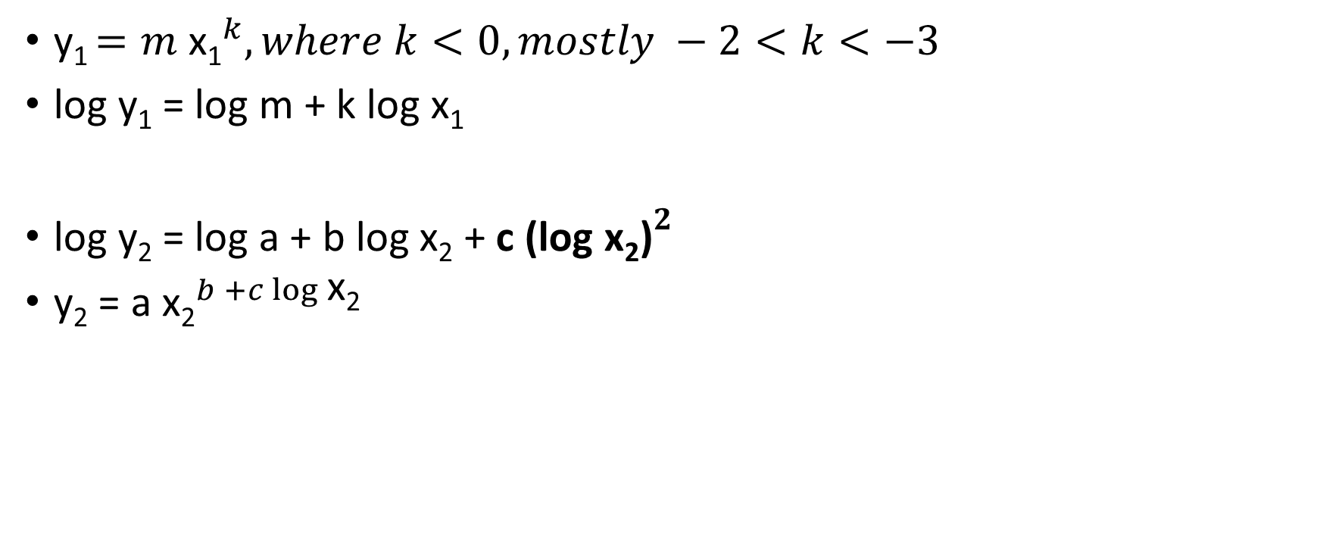
Inference of the curve of Quadratic regression
y₁ $=m{ \text{x}\text{1}}^{k}, where k<0, mostly −2<k<−3$
log y₁ = log m + k log x₁
log y₂ = log a + b log x₂ + c ${\text{(}\text{log} \text{x}\text{2}\text{)}}^{2}$
y₂ = a ${\text{x}\text{2}}^{b +c\log{\text{x}\text{2}}}$

Slide 16
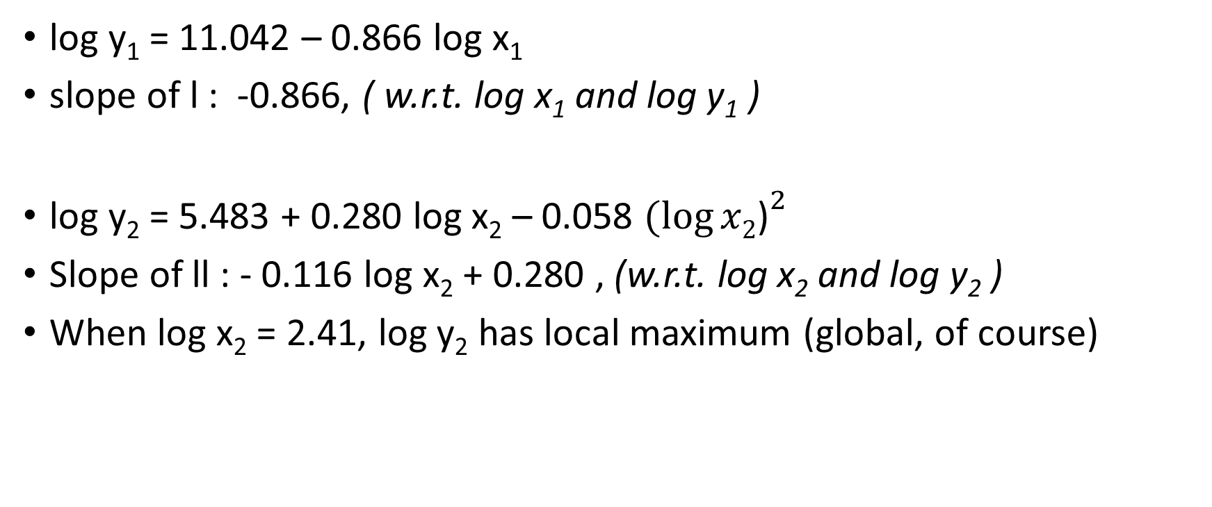
Differences between functions of two regressions
log y₁ = 11.042 – 0.866 log x₁
slope of l : -0.866, ( w.r.t. log x₁ and log y₁ )
log y₂ = 5.483 + 0.280 log x₂ – 0.058 ${(log⁡x2\text{)}}^{2}$
Slope of ll : - 0.116 log x₂ + 0.280 , (w.r.t. log x₂ and log y₂ )
When log x₂ = 2.41, log y₂ has local maximum (global, of course)

Slide 17
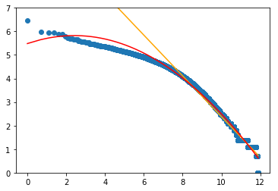
Why quadratic but not linear?

Slide 18
Why quadratic but not linear?
Avoid Curse of Dimensionality
Not worthy for only about a few hundreds of points when having
If we take higher order of regression in order to fit the data much more flawlessly, which lets extreme or exception points account for more in the regression and data overfitting the model, it will very likely to turn out with bad prediction and low compatibility while reading in new data.

Slide 19
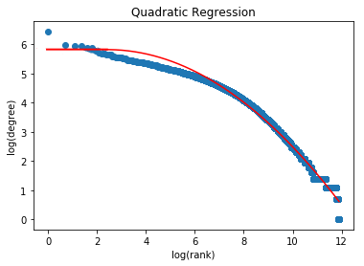
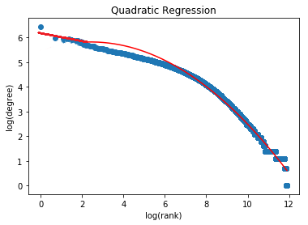
Adjustments of quadratic regression
Fit a flat line as log x₂ < 2.41
Fit a linear regression as log x₂ < 2.41

Slide 20
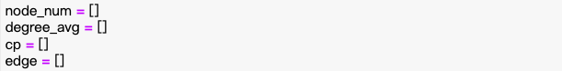
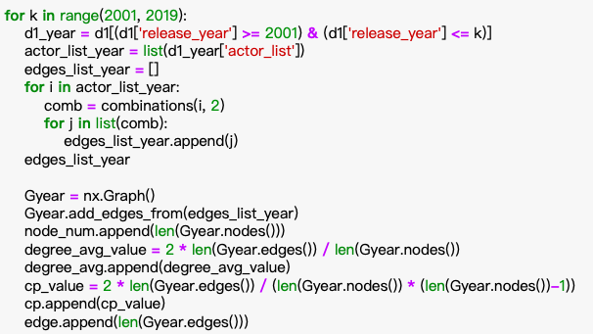
Evolution of the network over time
Split data
Create network
Evolution

Slide 21
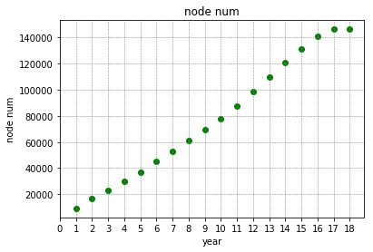
Number of nodes
The number of nodes will increase over time.
Because each time we join a year, the node may only increase or remain unchanged, and it is impossible to reduce.

Slide 22
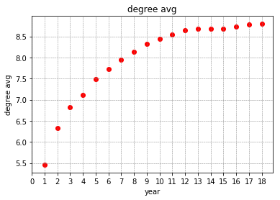
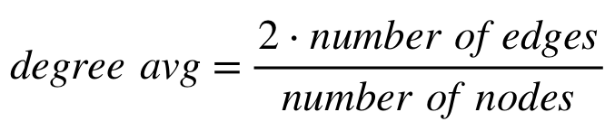
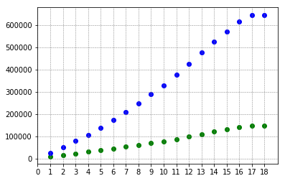
Degree average
The degree average will increase over time.
Because each time we join a year, the number of edges and nodes is increasing and the number of edges is increasing faster than nodes.

Slide 23
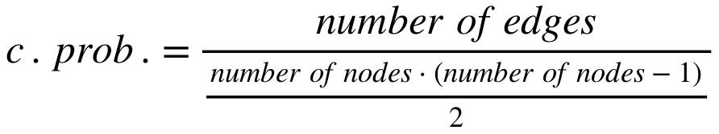
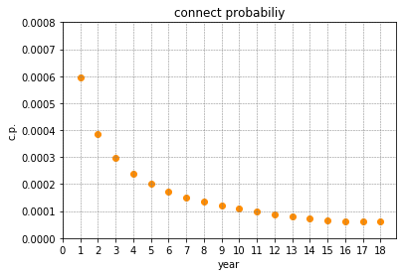
Connection probability
The connection probability will decrease over time.
Because each time we join a year, the number of edges and nodes is increasing and the square of the number of nodes is increasing faster than the number of edges.

Slide 24
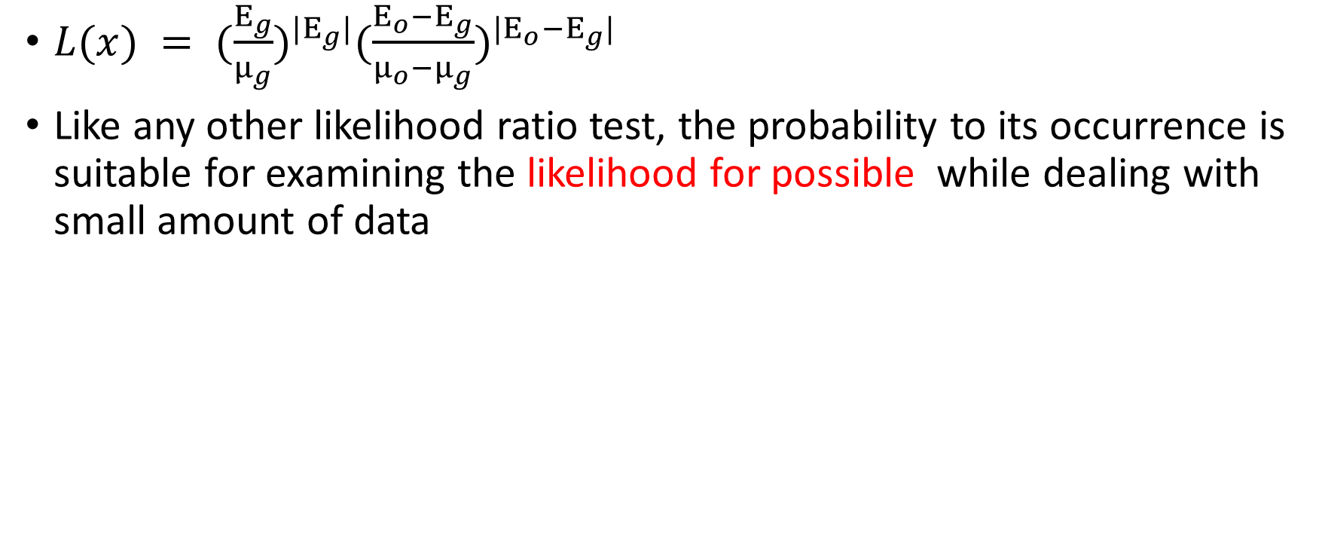
Likelihood ratio
$L(x) = {(\frac{E_{g}}{μ_{g}})}^{|E_{g}|}{(\frac{E_{o}−E_{g}}{μ_{o}−μ_{g}})}^{|E_{o}−E_{g}|}$
Like any other likelihood ratio test, the probability to its occurrence is suitable for examining the likelihood for possible while dealing with small amount of data

Slide 25
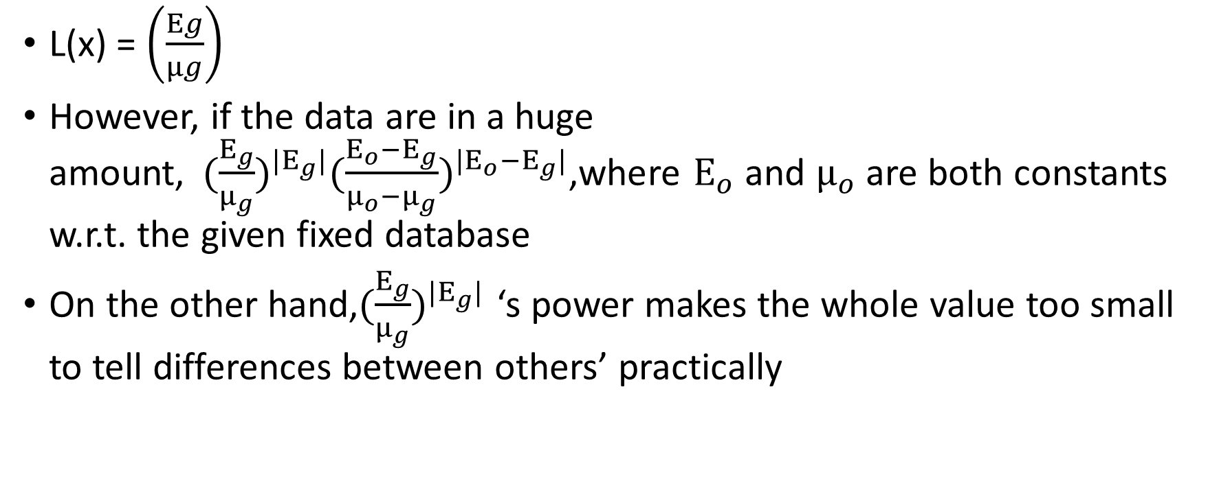
Refined Likelihood ratio
L(x) = $\left(\frac{Eg}{μg}\right)$
However, if the data are in a huge amount,${ (\frac{E_{g}}{μ_{g}})}^{|E_{g}|}{(\frac{E_{o}−E_{g}}{μ_{o}−μ_{g}})}^{|E_{o}−E_{g}|}$,where $E_{o}$ and $μ_{o}$ are both constants w.r.t. the given fixed database
On the other hand,${(\frac{E_{g}}{μ_{g}})}^{|E_{g}|}$ ‘s power makes the whole value too small to tell differences between others’ practically

Slide 26
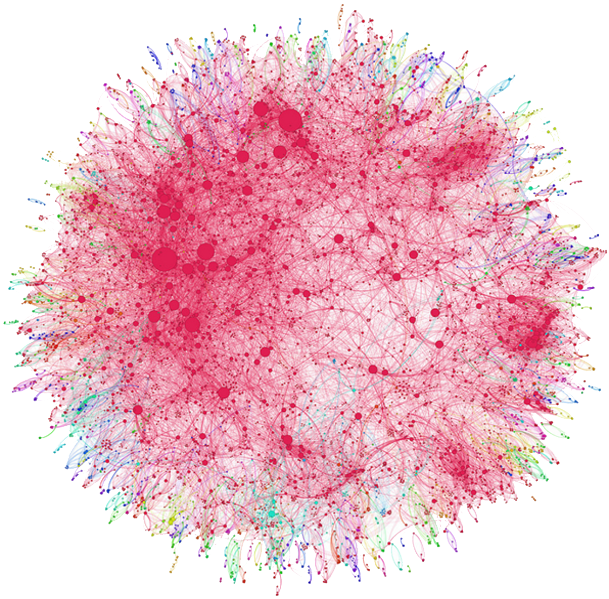
Communities generating
1
Clustering Algorithm
2
Flush the invalid Clusters
3
Hypothesis Testing

Slide 27
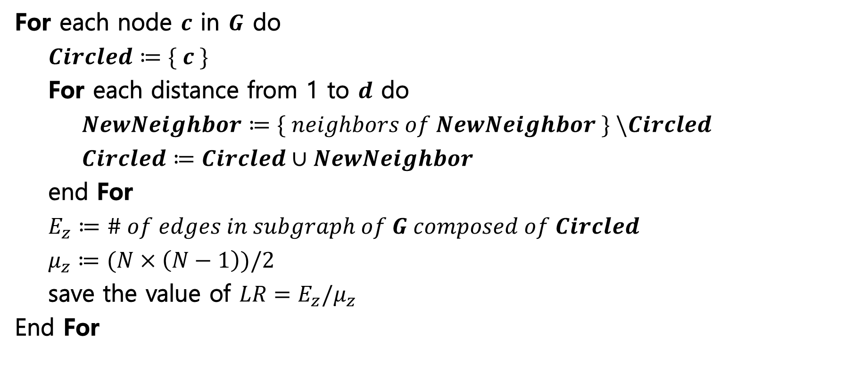
Cluster Algorithm
Input : graph $G$, with $N$ nodes. Expand distance: $d$.
Output : $LR$ of each Cluster expand from each node with distance $d$
Corporate BI (Centralized, Managed)
For each node $c$ in $G$ do
$Circled≔\{ c \}$
For each distance from 1 to $d$ do
$NewNeighbor≔\{ neighbors of NewNeighbor \} \backslash Circled$
$Circled≔Circled∪NewNeighbor$
end For
$E_{z}≔\# of edges in subgraph of G composed of Circled$
$μ_{z}≔(N×\left(N−1\right))/2$
save the value of $LR=E_{z}/μ_{z}$
End For

Slide 28
Purification of the population
Delete the Clusters having connection probability close to 1
Flush the clusters which are independent to the network
To distinguish whether a cluster is independent to the network, check if c.prob. of each cluster have the same value after any size extension.

Slide 29
Purification of the population
1q11
2
4
5
3
1
Flush the clusters which are independent to the network
To distinguish whether a cluster is independent to the network, check if c.prob. of each cluster have the same value after any size extension.

Slide 30
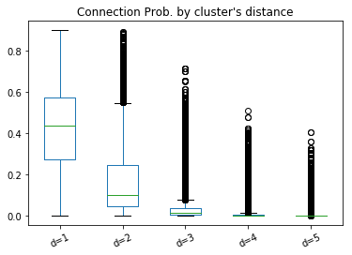
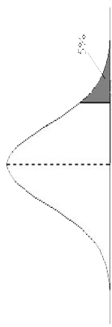
Rejection region
While merging the data of all distance, the rejection boundary of c.prob. comes to 0.53 at α= 0.05,

Slide 31
Rejection region
While merging the data of all distance, the rejection boundary of c.prob. comes to 0.53 at α= 0.05,
Which makes the cluster we picked having a bad quality and be dominated by the clusters with d=1.

Slide 32
Rejection region
So we do the interval estimation for cluster of each distance.
The new method provide us some communities of huge size to analysis.
0.74 0.45 0.16 0.06 0.02

Slide 33
Central seeking
and analysis
1
Parameter Generating
2
Focus Degree Centrality
3
Focus Picking and analysis

Slide 34
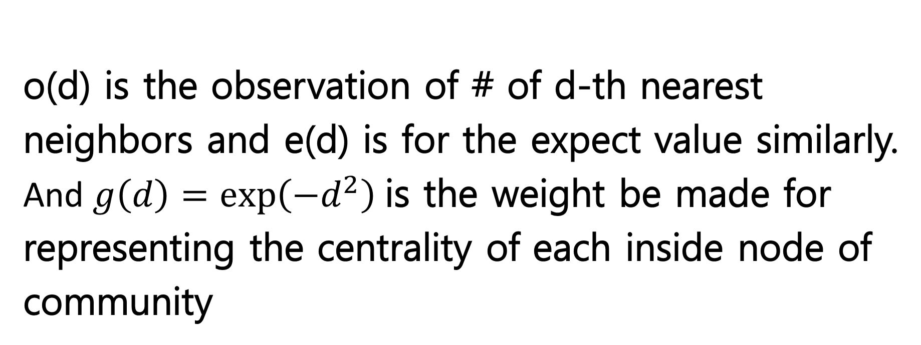
Focus Degree Centrality $F_{c}=Σ_{d=1}^{m}g\left(d\right)\left(0\left(d\right)−ⅇ\left(d\right)\right)$
Corporate BI (Centralized, Managed)
o(d) is the observation of # of d-th nearest neighbors and e(d) is for the expect value similarly.
And $g\left(d\right)=\exp\left(−d^{2}\right)$is the weight be made for representing the centrality of each inside node of community

Slide 35
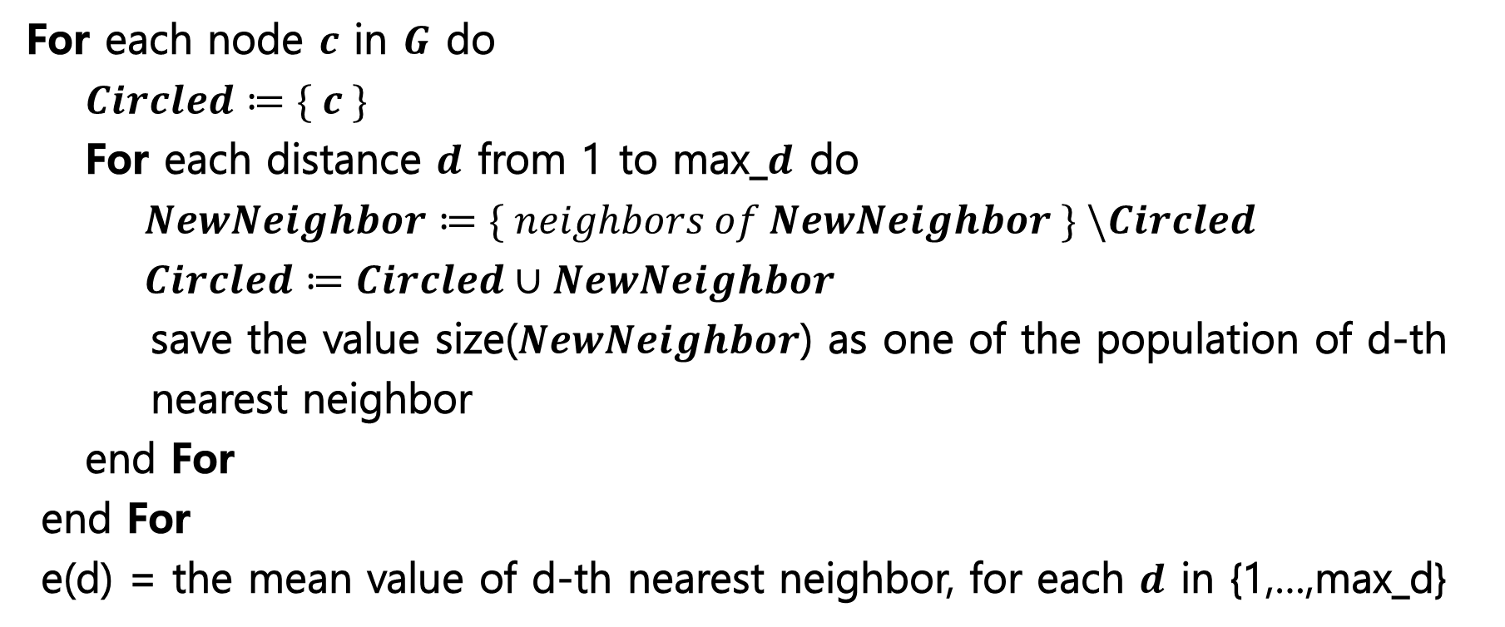
Expect value of k-th nearest neighbor calculation
Input : graph $G$, with $N$ nodes. Max expand distance: max_$d$.
Output : $e(d) = average \# of k−th nearest neighbors, for k in 1,…,max_d$
Corporate BI (Centralized, Managed)
For each node $c$ in $G$ do
$Circled≔\{ c \}$
For each distance $d$ from 1 to max_$d$ do
$NewNeighbor≔\{ neighbors of NewNeighbor \} \backslash Circled$
$Circled≔Circled∪NewNeighbor$
save the value size($NewNeighbor$) as one of the population of d-th nearest neighbor
end For
end For
e(d) = the mean value of d-th nearest neighbor, for each $d$ in {1,…,max_d}

Slide 36
Focus actor distribution
Community size>= 750
Find the most influence actors
Analysis actors
Classify the most influence actors
Find the most influence region around the world
India

Slide 37
Focus actor distribution
Ulrich Noethen Hannes Jaenicke
Henry Hübchen
Hannelore Elsner
Heino Ferch
John Cusack
Lacey Chabert
Jason Statham
Germany
America
Eric Tsang
Dwayne Johnson James Cameron
Ryan Gosling
Ryan Reynolds
Jim Carrey
Hong Kong
Canada
Fritz Karl
Anupam Kher
Aamir Khan
Salman Khan
Austria
India

Slide 38

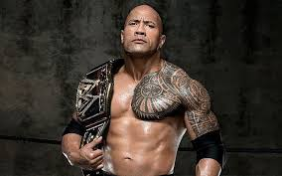
Focus actor distribution
Dwayne Johnson
Hong Kong
Eric Tsang
Austria
India

Slide 39
Result and Conclusion
Germany
Canada
Austria
Hong Kong
America
India

Slide 40
Thank you!

